Slide 1

Multiplexing & Demultiplexing
Goals: To understand the concept of multiplexing and demultiplexing.

Slide 2
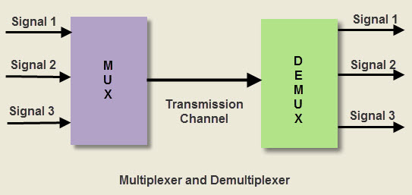
Introduction:
In-network transmission, both the multiplexer and demultiplexer are combinational circuits. A multiplexer selects an input from several inputs then it is transmitted in the form of a single line. An alternative name of the multiplexer is MUX or data selector. A demultiplexer uses one input signal and generates many. So it is known as Demux.

Slide 3
Multiplexing:
Multiplexing is a technique that allows the simultaneous transmission of multiple signals across a single data link.
There are three types of multiplexing techniques
    Time Division Multiplexing.
    Statistical Time Division Multiplexing.
    Frequency Division Multiplexing.
Time Division Multiplexing:
Different users use digital signal over one link by dividing time into slots or intervals and assigning them equally among these users.

Slide 4
Statistical Time Division Multiplexing:
    It is more efficient than TDM. By analyzing statistics related to the workload, need or priority and determines on-the-fly how much time each user should get.
    Frequency Division Multiplexing:
    FDM is a technique by which the total bandwidth available in a communication medium is divided into a series of non-overlapping frequency bands, each of which is used to carry a separate signal.
    De-Multiplexing:
    Demultiplexing (Demuxing) is a term relative to multiplexing. It is the reverse of the multiplexing process. Demultiplex is a process reconverting a signal containing multiple analog or digital signal streams back into the original separate and unrelated signals.
    Demultiplexers are classified into four types
    1-2 demultiplexer (1 select line)
    1-4 demultiplexer (2 select lines)
    1-8 demultiplexer (3 select lines)
    1-16 demultiplexer (4 select lines)

Slide 5
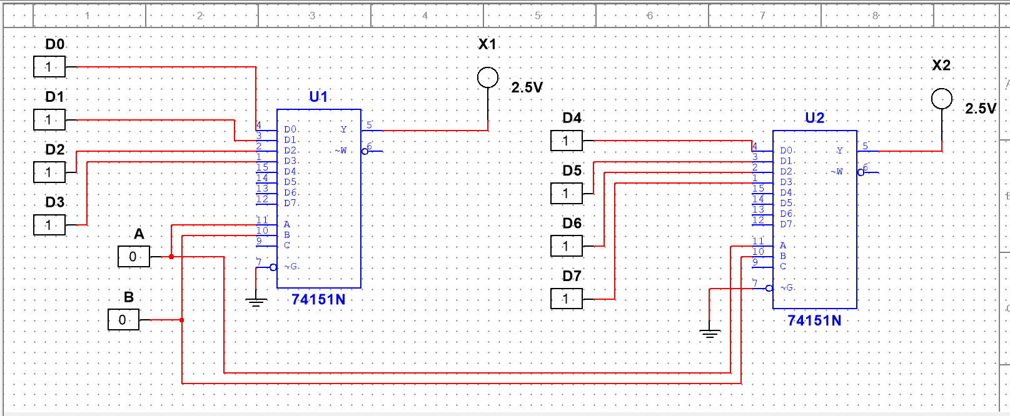
Multiplexing:

Slide 6
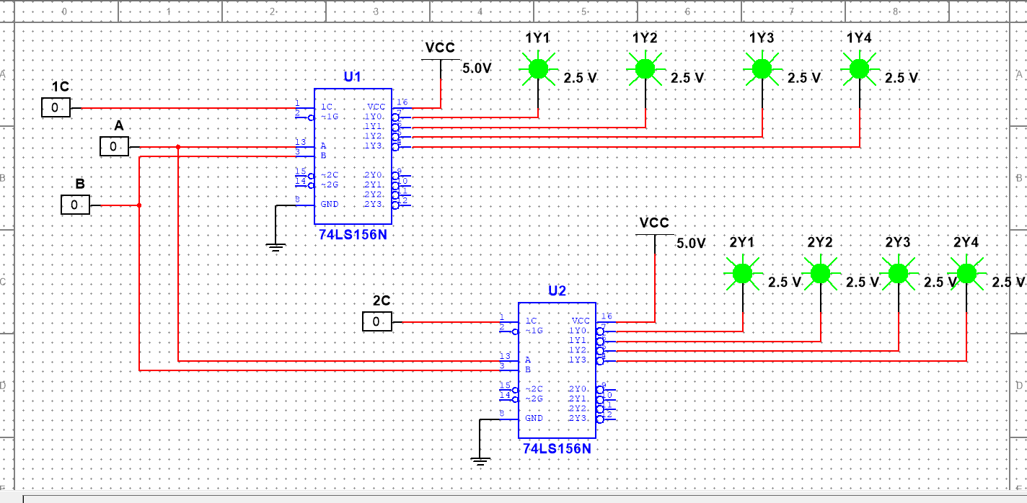
De-multiplexing

